Slide 1

Software for Cross Section measurements
04/05/2022
Giacomo Ubaldi

Slide 2
Global reconstruction
Global reconstruction of an event
Particle ID: Z,A
Kinematics: E,p
Angular distribution: θ
From SHOE branch “glbreco_v1”:
libs/src/TAGfoot/GlobalRecoAna.cxx
.root file with histograms of
variable distribution
Aim of the new software:
Measure differential cross section σ (Z,A,θ,E)
wrt all combination of variables
Written in python
G. Ubaldi

Slide 3
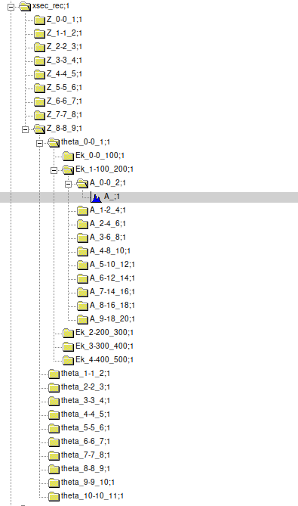
Z
Exampe of
Input file
From SHOE
θ
E
There are only histos of A
Every subdirectory is due to
input binning of the variable
Every histo is univocally discriminated
by its path
A
The software
takes info dinamically about input
variables and binning
Generates differential distribution
wrt all combinations of variables
G. Ubaldi

Slide 4
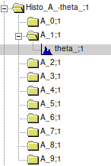
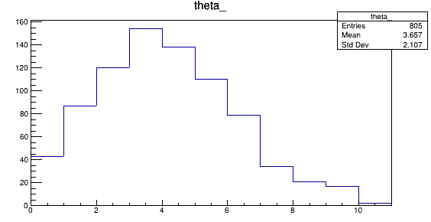
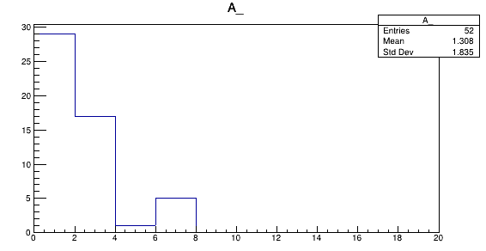
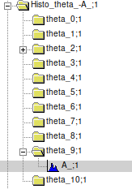
Es. beam of O_16 of 200 Mev/n against a target of C2H4 (MC)
Write_Histo_events ("A_/theta_", eventContainer, outFile,inputPar_dict)
A_1: 2<A<4 amu
    0°<θ<11°
Angle °
Write_Histo_events ("theta_/A_", eventContainer, outFile,inputPar_dict)
θ_9: 9°<θ<10°
    0<A<20 amu
Mass (amu)
G. Ubaldi

Slide 5
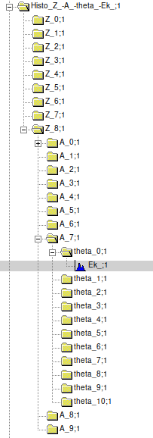
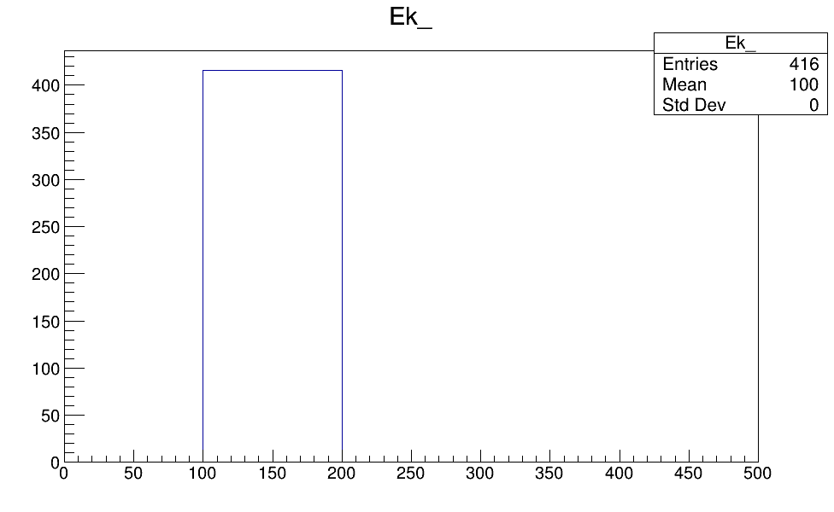
4 – differential distribution
Write_Histo_events ("Z_/A_/theta_/Ek_", eventContainer, outFile,inputPar_dict)
Z = 8
14<A<16
0°<θ<1°
G. Ubaldi

Slide 6
To do:
Choose output binning in agreement with the input one
Apply unfolding
Do TH2 histograms
Do it for signal, background and systematics
Obtain final differential cross section
https://baltig.infn.it/gubaldi/xshoe
G. Ubaldi

